Slide 1
INTRODUCTION TO DATA MANAGEMENT
Presentation by: LOVELEEN VERMA
Registration no.:11912122

Slide 2
ABOUT THE PROJECT
01
What is my project all about?

Slide 3

ABOUT THE PROJECT:
The Olympic Games began in ancient Greece.
The original Greek games were staged every fourth year for several hundred years, until they were abolished in the early Christian era. The revival of the Olympic Games took place in 1896, and since then they have been staged every fourth year, except during World War I and World War II (1916, 1940, 1944).
The evolution of the Olympic Movement during the 20th and 21st centuries has resulted in several changes to the Olympic Games.

Slide 4
Gathering information about Past Olympic Events can further help us to predict about the results of upcoming Olympic Games. More information about the data on which I have performed the analysis, about the website from where I have taken this data and about the important steps involved in the analysis is as follows:
This is a historical dataset on the modern Olympic Games, including all the Games from Athens 1896 to Rio 2016.
The main dataset is from Kaggle - 120 years of Olympic history: athletes and results
Also for more information about the host city and countries, I had collected data from Wikipedia.
This dataset provides an opportunity to ask questions about how the Olympics have evolved over time, including questions about the participation and performance of women, different nations, and different sports and events.
I did Exploratory Data Analysis (EDA) and Feature Selection to get better results.
I did Data Analysis to get the important insights from the data to answer my objectives.
Then built a Dashboard for this dataset using MS Excel.

Slide 5
DATA
02
About the data I have used….

Slide 6
DATA:
ATHLETE_EVENTS.CSV
ID - Unique number for each athlete
Name - Athlete's name
Sex - M or F
Age - Integer
Height - In centimetres
Weight - In kilograms
Team - Team name
NOC - National Olympic Committee 3-letter code
Games - Year and season
Year – Integer (Year in which Olympic happens)
Season - Summer or Winter
City - Host city
Sport - Sport
Event - Event
Medal - Gold, Silver, Bronze, or NA
NOC_REGIONS.CSV
NOC- National Olympic Committee 3-letter code
Region- Name of Country for corresponding NOC code
HOST CITY DATA
City- Host city
Country- Host Country
Year- Integer (Year in which Olympic happens)
Continent- Name Of Continent of host country
Summer- Contain a value if Summer Olympic happen in corresponding year
Winter- Contain a value if Winter Olympic happen in corresponding year
Opening Ceremony- Date of opening ceremony
Closing Ceremony- Date of closing ceremony

Slide 7
SOURCE OF DATASET?
03
From where I have taken this Data…

Slide 8

SOURCE OF DATASET?
This dataset that I have taken is from KAGGLE. Kaggle, a subsidiary of Google LLC, is an online community of data scientists and machine learning practitioners. Kaggle allows users to find and publish data sets, explore and build models in a web-based data-science environment, work with other data scientists and machine learning engineers, and enter competitions to solve data science challenges.
Also, the data for Host Countries is taken from an article about Olympics on Wikipedia.

Slide 9
SOURCE OF DATASET?
You can view the dataset at:
DATASET
Also, the data for Host Countries is taken from an article about Olympics on Wikipedia. The link for that Data is here-
DATA ON WIKIPEDIA
After extracting the raw data and storing it in a excel file, I have uploaded that data on Google Drive. The link for the same is as follows-
HOST CITY DATA ON DRIVE

Slide 10
DASHBOARD
04
Glimpse of the dashboard generated…

Slide 11
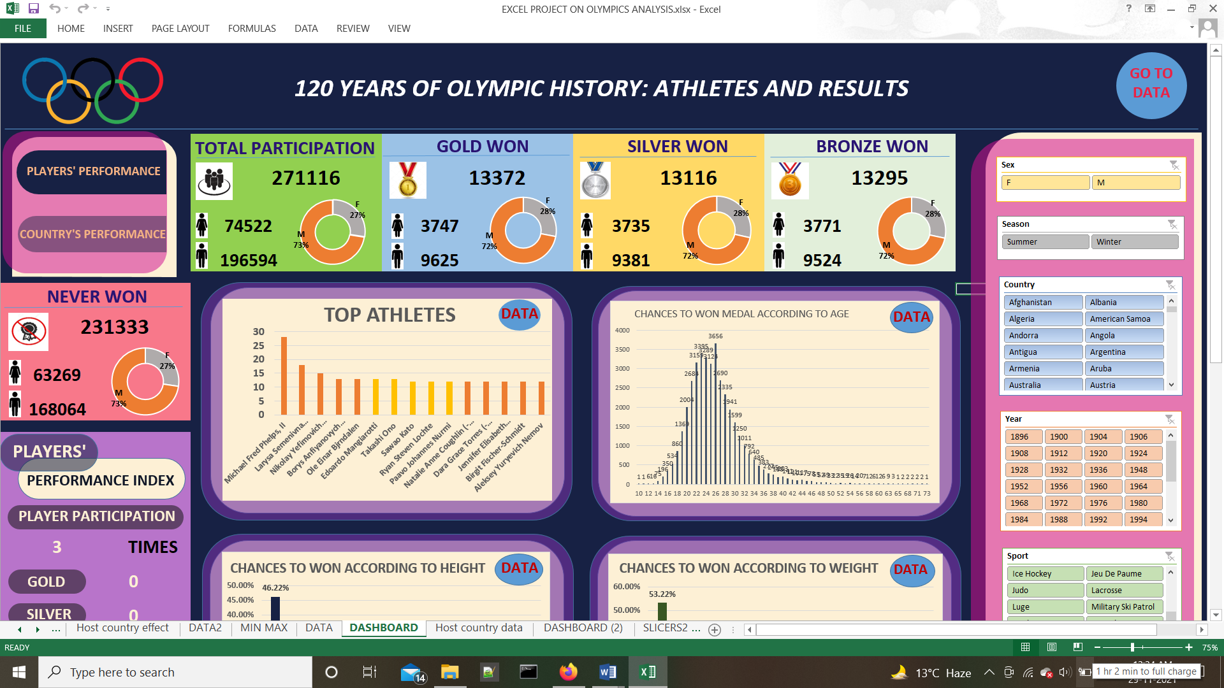
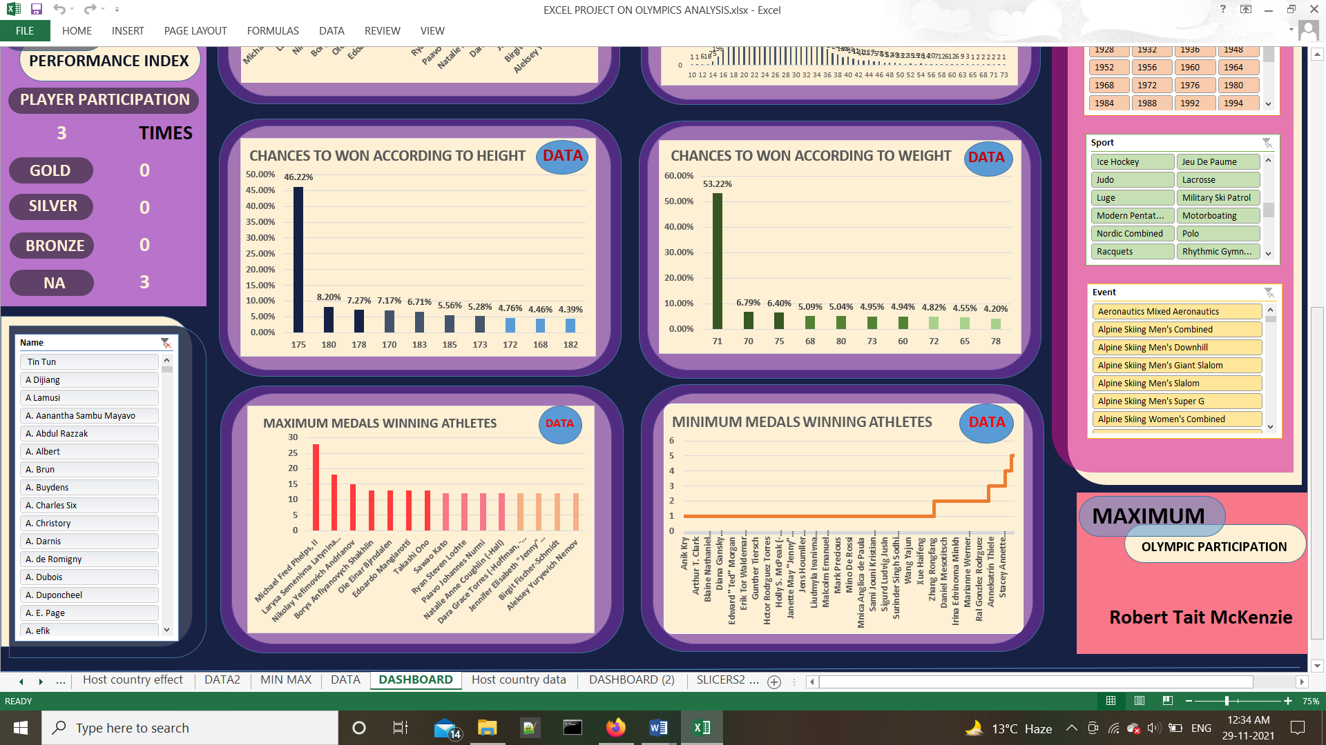

Slide 12
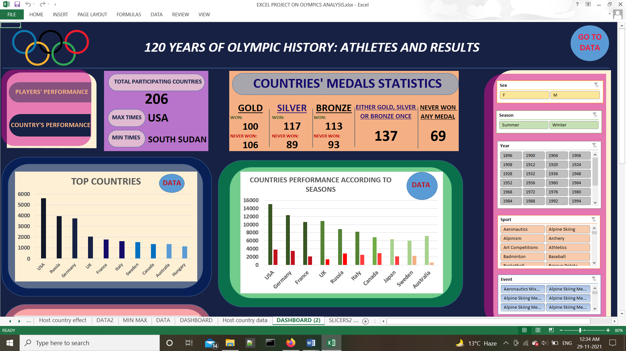
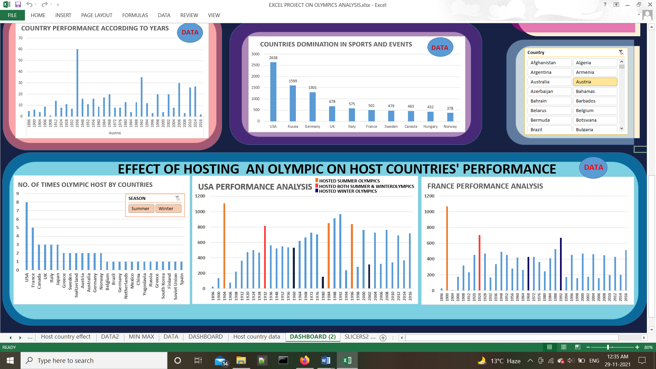

Slide 13
DATA ANALYSIS AND RESULTS
05
Objectives and their outcomes generated…

Slide 14

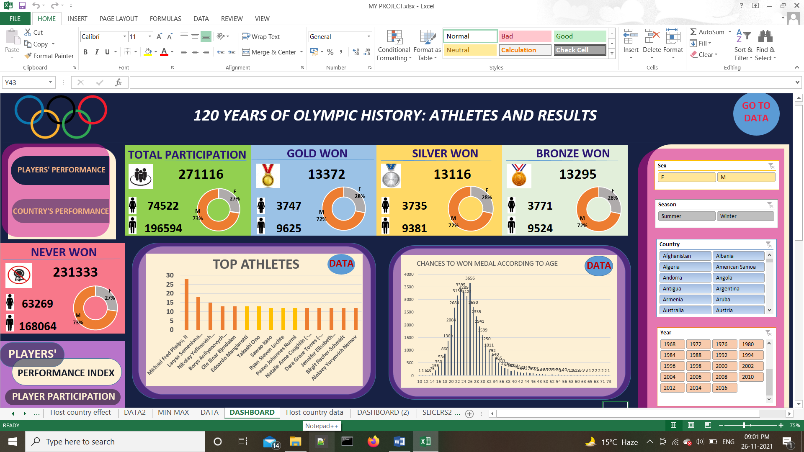
ANALYSIS AND RESULTS:
01
What are the total number and percentage of female and male participated in an Olympics according to season, year, sports, events or countries.
IN SUMMER OLYMPICS:
TOTAL PARTICIPANTS: 222552
FEMALE PARTICIPANTS: 59443 (27%)
MALE PARTICIPANTS: 163109 (73%)
IN WINTER OLYMPICS:
TOTAL PARTICIPANTS: 48564
FEMALE PARTICIPANTS: 15079 (31%)
MALE PARTICIPANTS: 33485 (69%)
for year 1972
TOTAL PARTICIPANTS: 11959
FEMALE PARTICIPANTS: 2608 (22%)
MALE PARTICIPANTS: 9351 (78%)
for AFGANISTAN
TOTAL PARTICIPANTS: 126
FEMALE PARTICIPANTS: 5 (4%)
MALE PARTICIPANTS: 121 (96%)
Here one thing that need to be focussed is that in none of the cases the percentage of female arise up to or equals to 50%. That means we need to focus on our female athletes.

Slide 15
ANALYSIS AND RESULTS:
02
What are the total number and percentage of female and male won a different medal in an Olympics according to season, year, sports, events or countries.

Slide 16
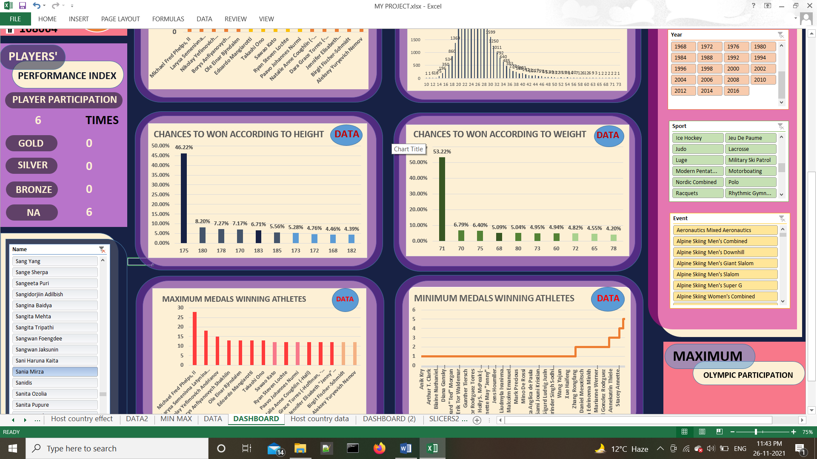
ANALYSIS AND RESULTS:
03
Individual Player analysis- Total participation, no. of Gold, Silver and Bronze medal.

Slide 17
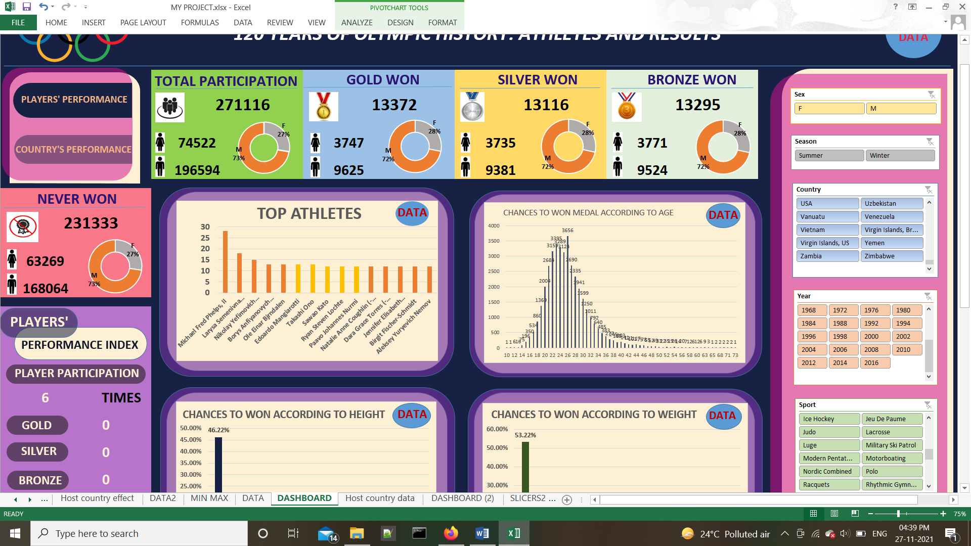

ANALYSIS AND RESULTS:
04
TOP PERFORMANCE:
Top countries and athletes who won medal according to year, sex (female or male), sports, events or seasons.
In Summer Olympics:
USA with 5002 medals
In Winter Olympics:
Russia with 759 medals
TOP PERFORMING ATHLETES:
MALE: Michael Fred Phelps, II with 28 medals
FEMALE: Larysa Semenivna Latynina (Diriy-) with 18 medals

Slide 18
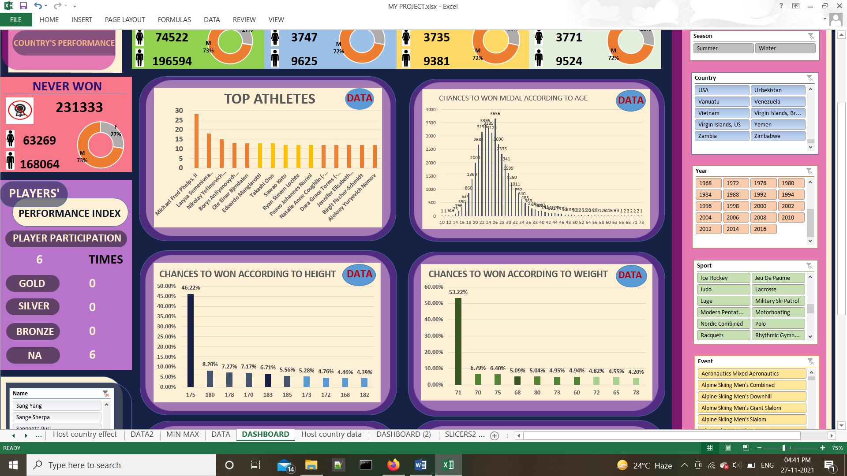
ANALYSIS AND RESULTS:
The analysis shows that the athletes with 175 cm of height have won the 46.22% of medals. While after this the maximum medals are being won by athletes with 180 cm height with is only 8.20% of medals.
NOTE:
05
Specific to Males also shows that male athletes with 175 cm of height won 50.39% of medals, the next is 180 cm with 7.92% of medals.
In case of female athletes also the height 175 cm shows high percentage of winning medals as female athletes with 175 cm of height win 22.02% of medals, while next is 170 cm with 13.41% of medals.
Does age, height and weight plays an important role in winning a medal?

Slide 19
ANALYSIS AND RESULTS:
Analysing about the age and no of medals they won, I came to know that the athletes within the age from 20 – 28 won maximum number of medals as compared to the athletes with ages above and below them.
NOTE:
05
Within 20-28, Athletes with age 26 have won the maximum no of medals (3656 medals).
The athletes within the age of 34 to 40 won very less medals as compared to the age group 20-28 and this graph falls down even more worse for higher age athletes that is above 40. In conclusion, Age have an important impact on athlete’s performance and athletes with age within 20-28 especially 26 years are have more certainty to win a medal.
Does age, height and weight plays an important role in winning a medal?

Slide 20
ANALYSIS AND RESULTS:
The analysis shows that the athletes with 71 kg of weight is more likely to win a medal as they have won the 53.22% of medals. The next one after this is the 70 kg category but they have won only 6.79 % of medals.
NOTE:
05
Specific to Males also shows that male athletes with 71 kg of weight won 58.38% of medals, the next is 75 kg with 6.11% of medals.
In case of female athletes also the weight 71 kg shows high percentage of winning medals as female athletes with 71kg of weight win 20.68% of medals, while next is 60 kg with 10.63% of medals.
Does age, height and weight plays an important role in winning a medal?

Slide 21
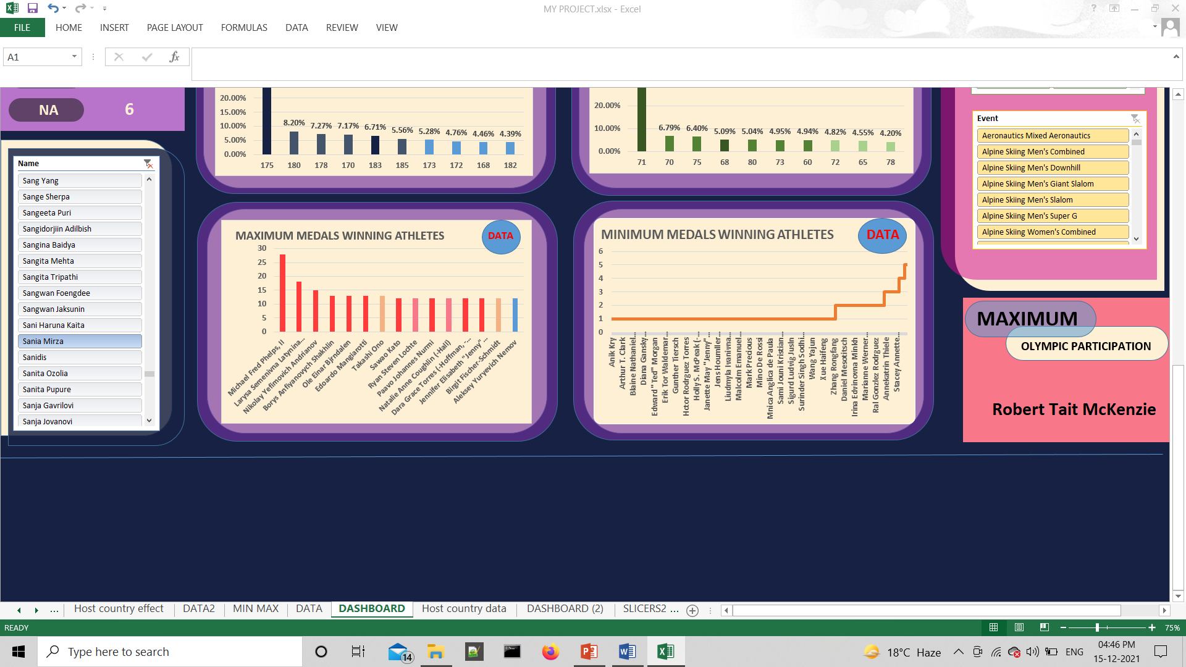
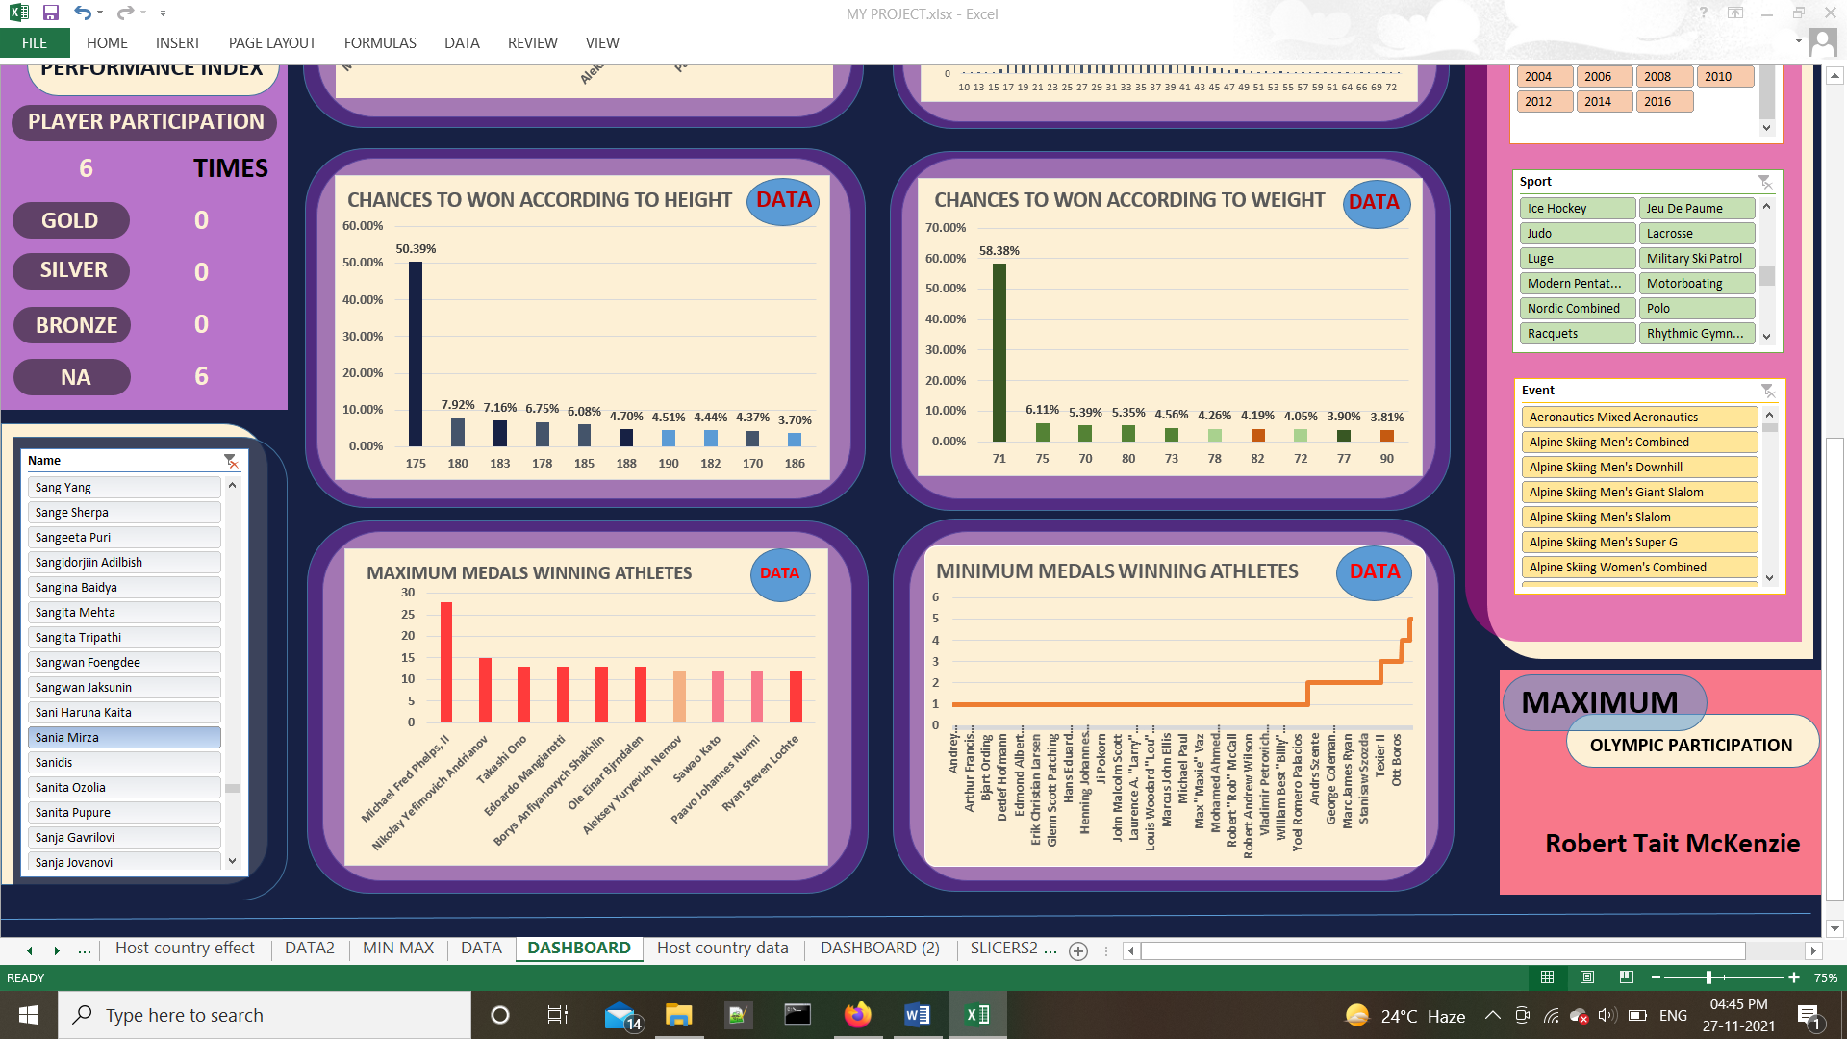
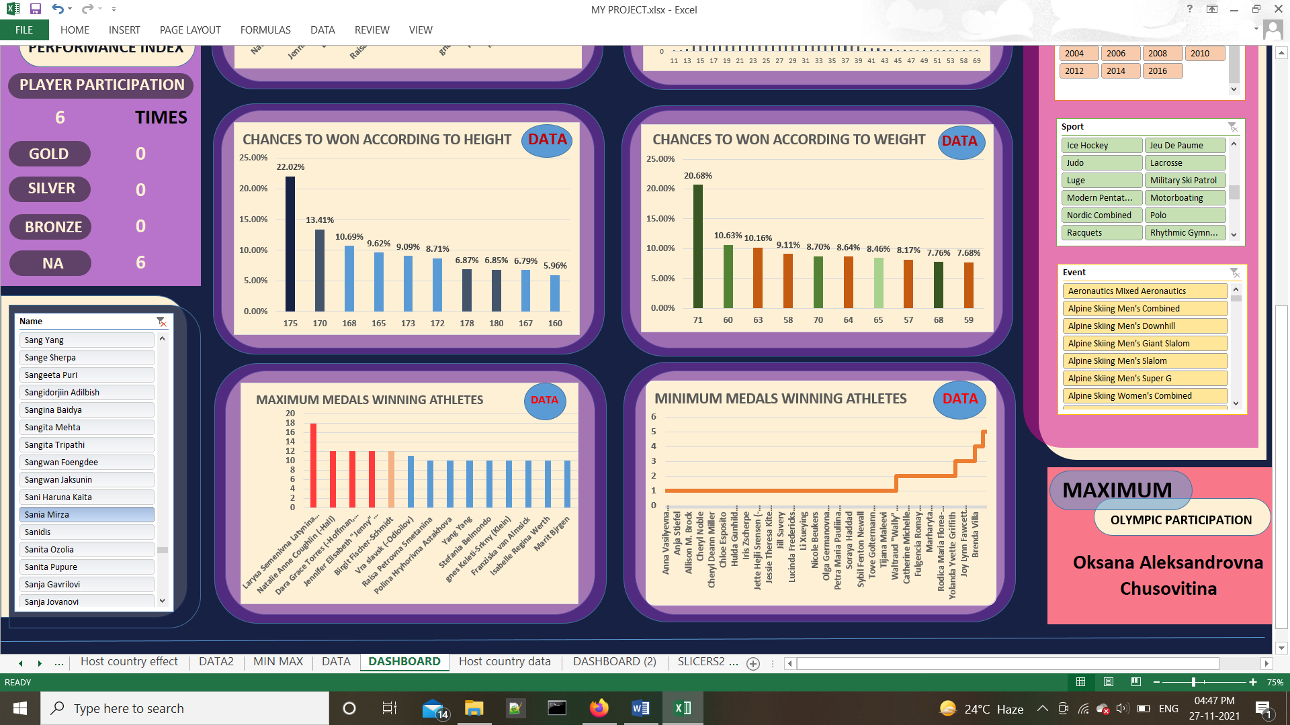
ANALYSIS AND RESULTS:
MAXIMUM MALE: Michael Fred Phelps, II FEMALE: Larysa Semenivna Latynina
06
Which athlete won maximum and which won minimum medals in Olympics according to Year, Season, Sports and gender.

Slide 22
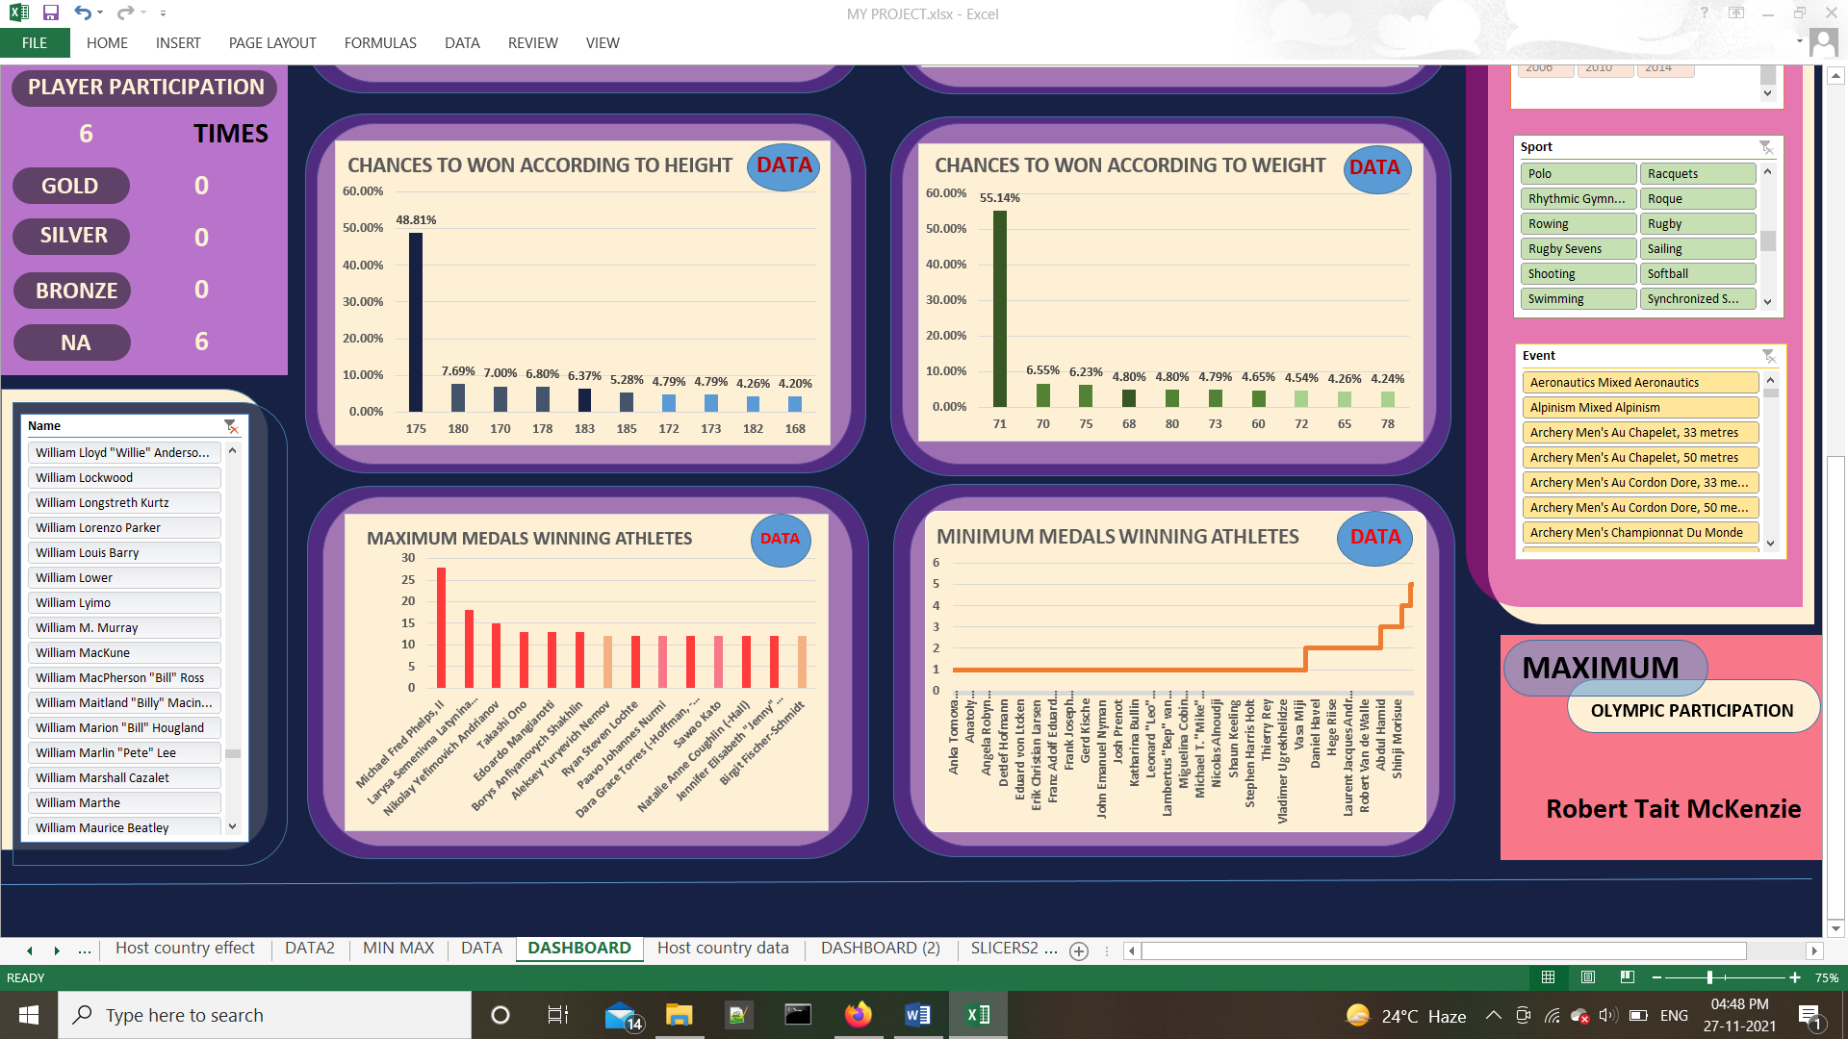
ANALYSIS AND RESULTS:
OVERALL MAXIMUM PARTICIPATING ATHLETE: Robert Tait McKenzie MAXIMUM PARTICIPATING ATHLETE AMONG MALES: Robert Tait McKenzie MAXIMUM PARTICIPATING ATHLETE AMONG FEMALES: Oksana Aleksandrovna Chusovitina MAXIMUM PARTICIPATING ATHETE IN SUMMER OLYMPICS: Robert Tait McKenzie
07
MAXIMUM PARTICIPATING ATHLETE IN WINTER OLYMPICS: Ole Einar Bjrndalen MAXIMUM PARTICIPATING ATHLETE IN WINTER OLYMPICS IN FEMALES: Gabriella Paruzzi
Which athlete appeared in Olympics for most of the time?

Slide 23
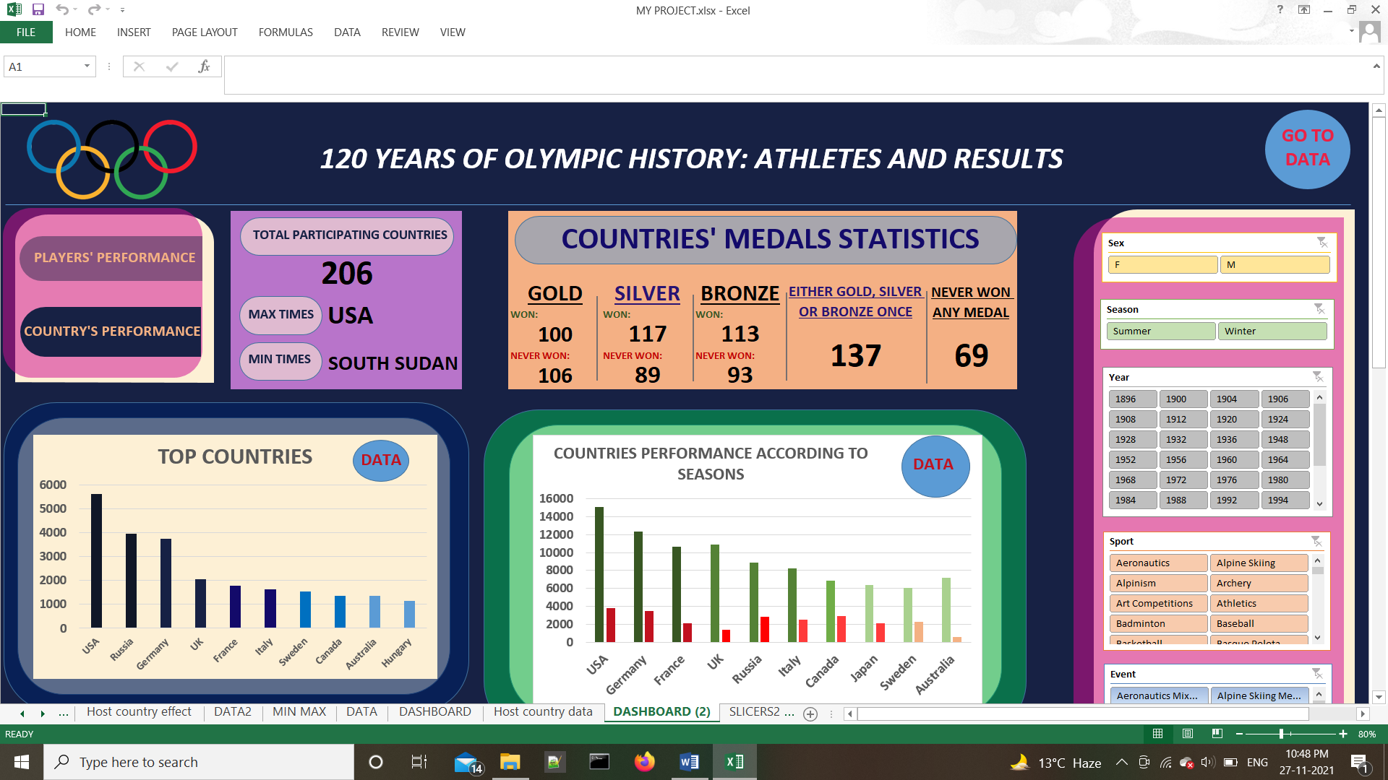
ANALYSIS AND RESULTS:
08
How many countries won at least one medal or never won any medal in Olympics?
How many countries won at least once or never won a Gold medal in Olympics?
How many countries won at least once or never won a silver medal in Olympics?
How many countries won at least once or never won a bronze medal in Olympics?

Slide 24
ANALYSIS AND RESULTS:
09
How Seasons affect the countries’ performance in Olympic Games.
The interesting fact here what we can observe is that the countries which perform great in summer Olympics are also very well in winter Olympics except for some. Like here for Italy and Japan.
COUNTRY | SUMMER | WINTER
USA | 15064 | 3789
Germany | 12377 | 3506
France | 10633 | 2125
UK | 10917 | 1339
Russia | 8855 | 2837
Italy | 8217 | 2498
Canada | 6861 | 2873
Japan | 6336 | 2108
Sweden | 6076 | 2263
Australia | 7178 | 546

Slide 25
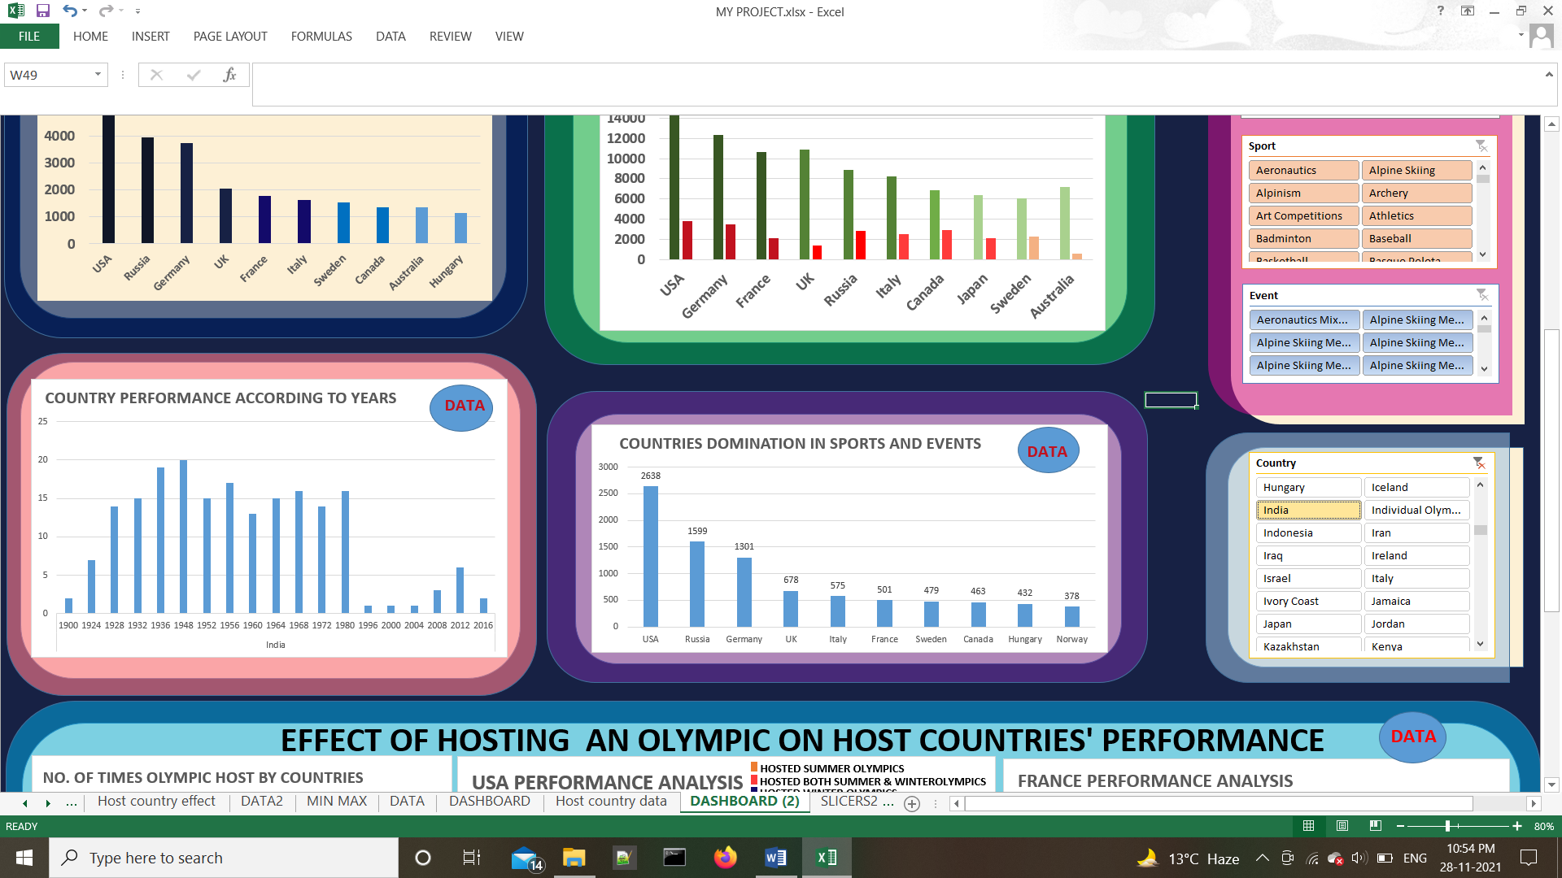
ANALYSIS AND RESULTS:
10
Performance of a country according to year.
INDIA

Slide 26
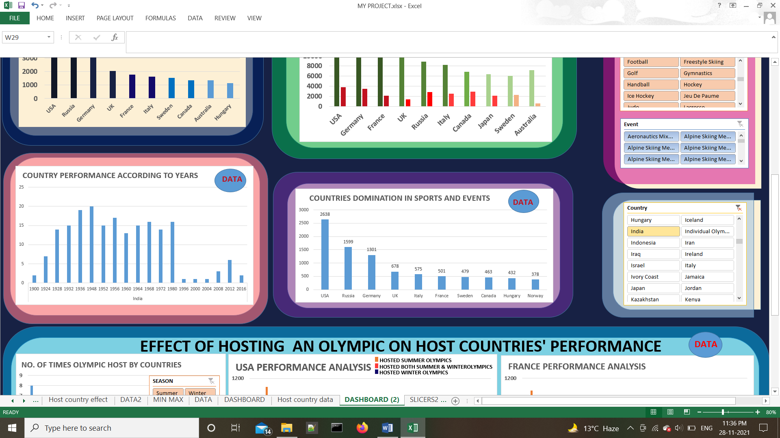
ANALYSIS AND RESULTS:
THE DOMINATED TOP 10 COUNTRIES IN OLYMPICS IS: USA>Russia>Germany>UK>Italy>France>Sweden>Canada>Hungary>Norway THE DOMINATED COUNTRIES IN SUMMER OLYMPICS IS: USA>Russia>Germany>UK>Italy>France>Hungary>Australia>Sweden>China THE DOMINATED COUNTRIES IN WINTER OLYMPICS: Russia>Canada>Germany>USA>Norway>Sweden>Austria>Switzerland>Finland>Italy
11
THE DOMINATED COUNTRIES IN OLYMPICS IN FOOTBALL: USA>Hungary>UK>Russia>Germany>Argentine>Uruguay>Cameroon>Brazil>Poland>Spain>Norway
Which Country shows domination in which sport by winning gold medal.

Slide 27
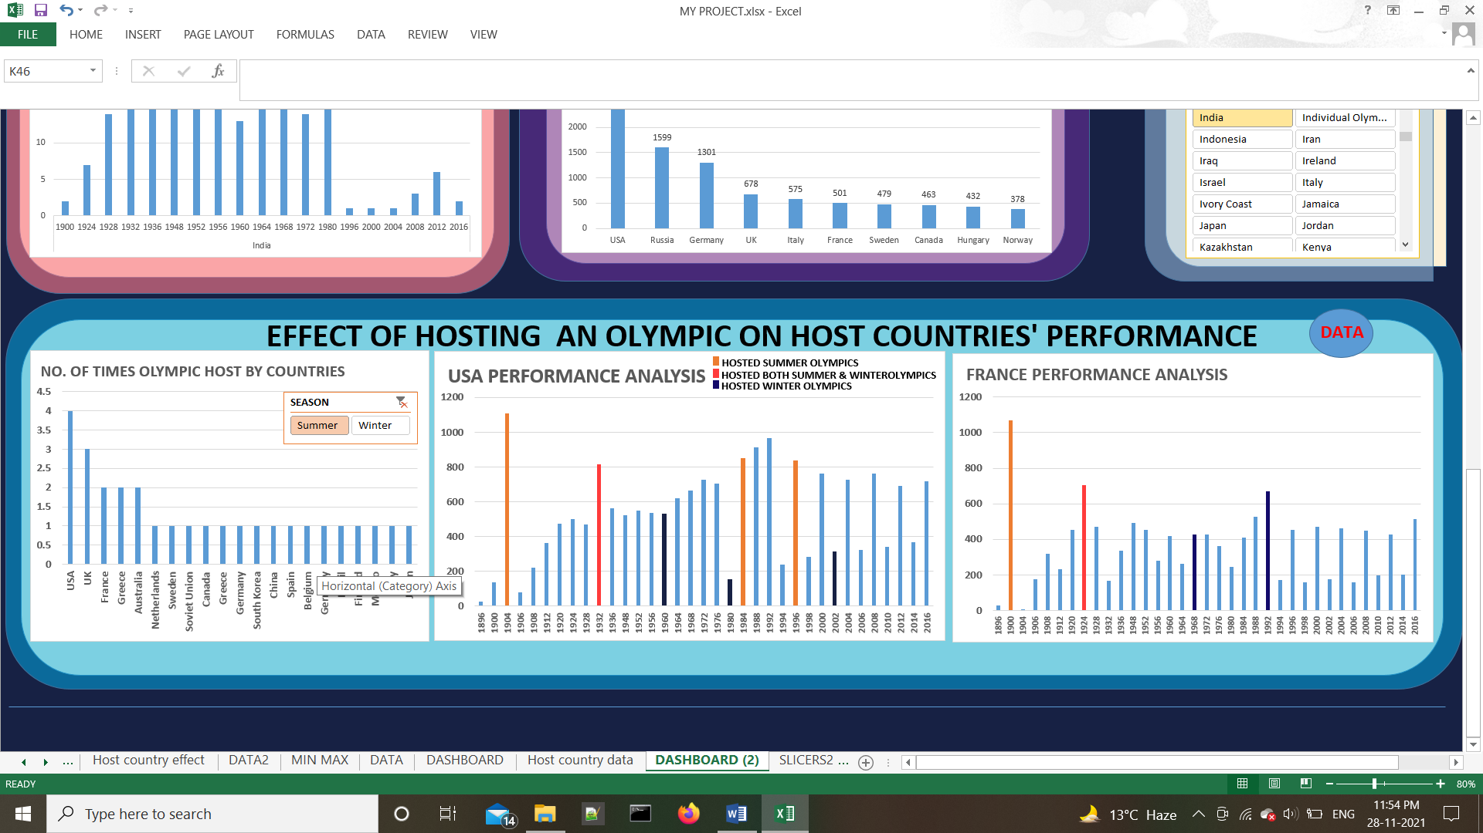
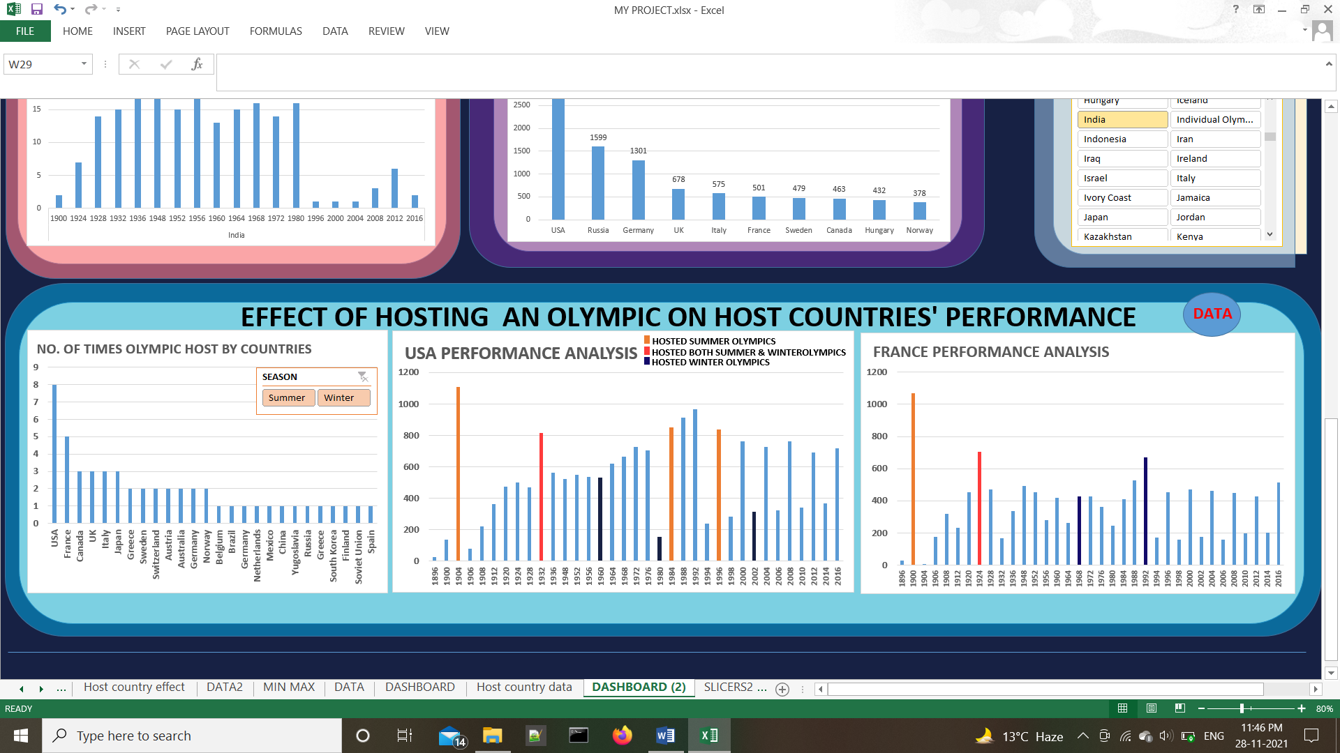
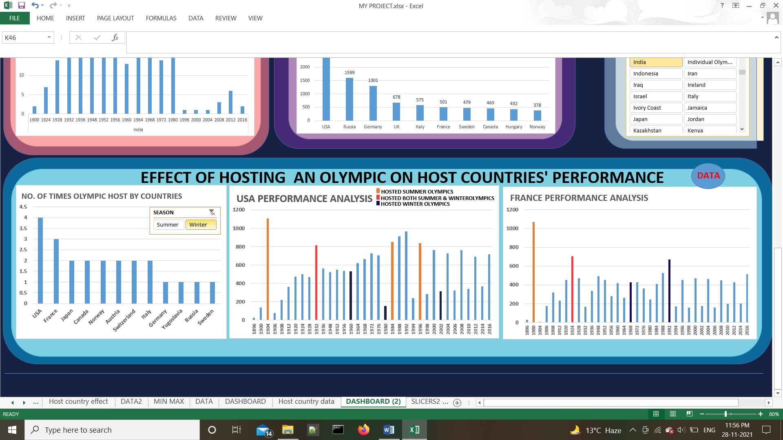
ANALYSIS AND RESULTS:
12
Effect of hosting an Olympic on host country’s performance?
So as we came to know that maximum times USA hosted the Olympics and then France.

Slide 28
From above the big orange bars clearly showcase that whenever USA hosted Summer Olympics its performance is extremely well and in that year USA has won above 800 medals every time.
The small navy blue bars is for hosting winter Olympics. Although they are not that much giant but still if we compare them to the performance of USA only in winter Olympics then they are also pretty well.
Also one thing that needed to be focus is that in 1904 USA hosted the Olympics for the very first time and before that its performance in Olympics is very poor. But after it hosted the graph of USA arises in every upcoming Olympic event.
Like USA, France being the second country who has hosted Olympics for maximum number of times. Here also we can see the big bars in orange, pink and navy blue colours wonderfully depicting that how well France have performed when it hosted the Olympics.
Moreover the performance of France has also being improving in every upcoming Olympic event after it hosted the Olympics.

Slide 29
THANK YOU

